Slide 1
Tasks for array and strings

Slide 2
TASK-1
Write a program to reverse the elements of a one-dimensional array. in java for user defined input?

Slide 3
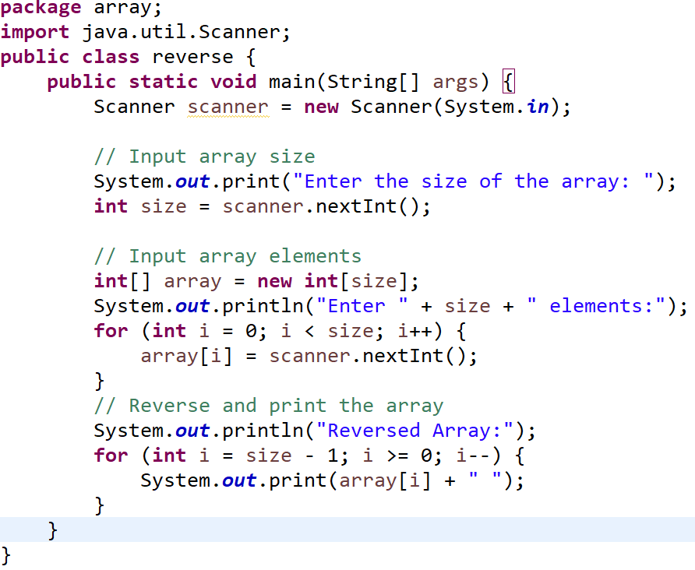

Slide 4
TASK-2
Write a Java program to sort an array in ascending?

Slide 5
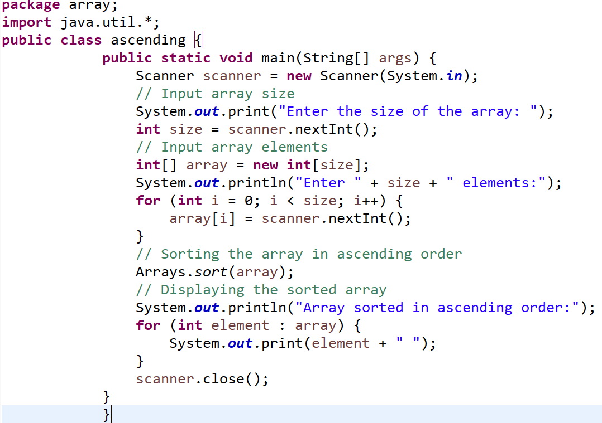

Slide 6
TASK-3
Write a Java program to sort an array in descending order.

Slide 7
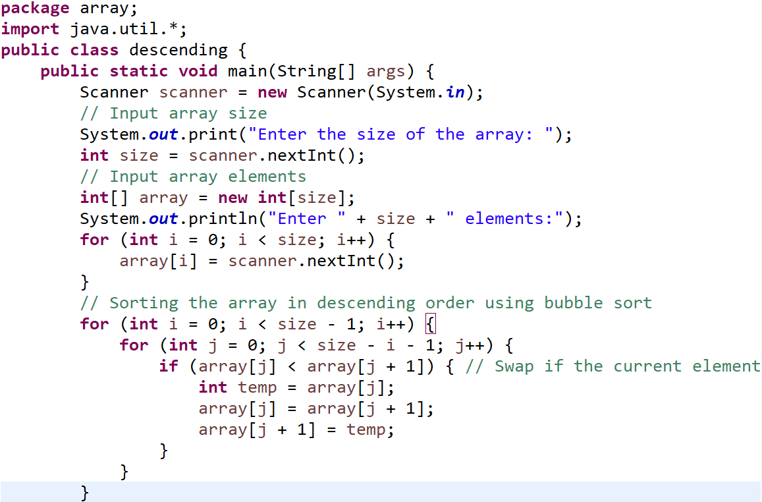

Slide 8
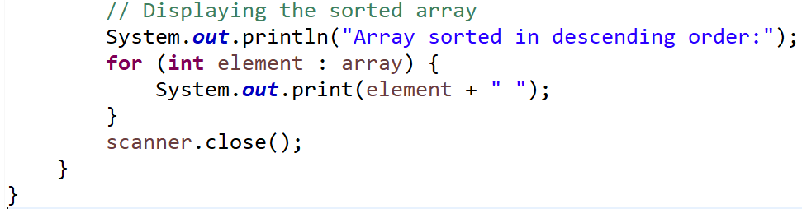

Slide 9
TASK-4
Write a program to declare, initialize, and print a 2D array.

Slide 10
TASK-5
Write a program to find the sum of all elements in an array.

Slide 11
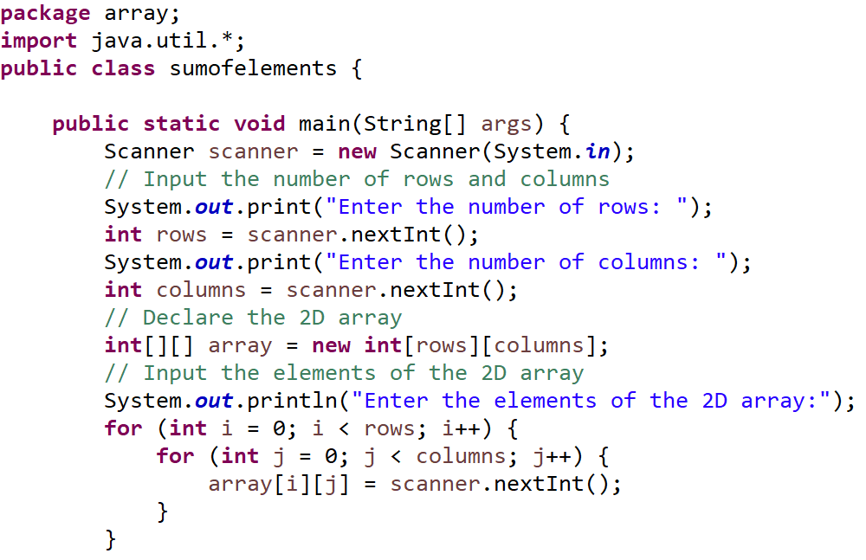

Slide 12
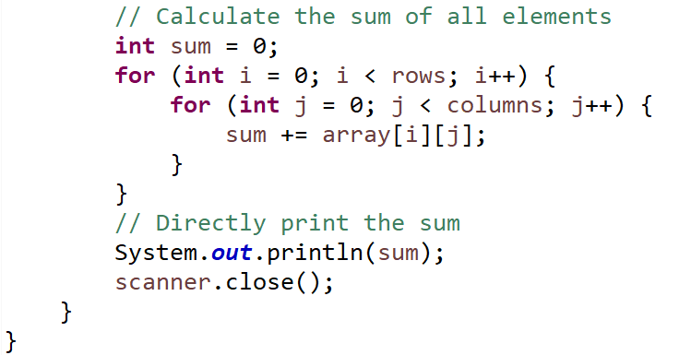

Slide 13
TASK-6
Write a program to reverse a string without using the inbuilt class.

Slide 14
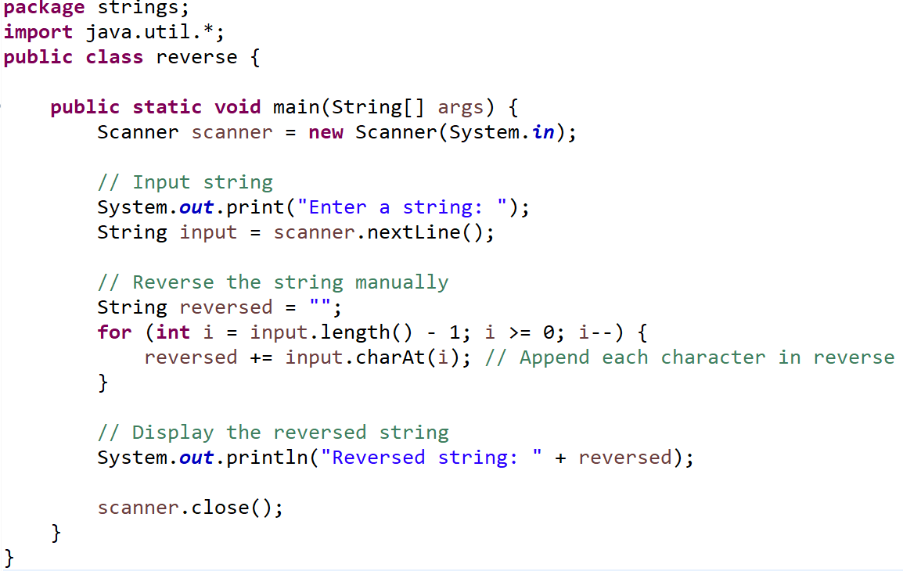

Slide 15
TASK-7
How do you count the number of vowels and consonants in a string?

Slide 16
package strings;
import java.util.*;
public class vowelsconsonant {
public static void main(String[] args) {
Scanner scanner = new Scanner(System.in);
// Input string
System.out.print("Enter a string: ");
String input = scanner.nextLine().toLowerCase(); // Convert to lowercase for uniformity

Slide 17
int vowels = 0, consonants = 0;
// Loop through each character in the string
for (int i = 0; i < input.length(); i++) {
char ch = input.charAt(i);
// Check if the character is a vowel
if (ch == 'a' || ch == 'e' || ch == 'i' || ch == 'o' || ch == 'u') {
vowels++;
}
// Check if the character is a consonant (alphabetic but not a vowel)
else if (ch >= 'a' && ch <= 'z') {
consonants++;
}
}

Slide 18
// Output the counts
System.out.println("Number of vowels: " + vowels);
System.out.println("Number of consonants: " + consonants);
scanner.close();
}
}

Slide 19
TASK-8
Write a program to find the frequency of each character in a string.

